Slide 1
Be the Change and Make a Difference
Anti-Bullying

Slide 2
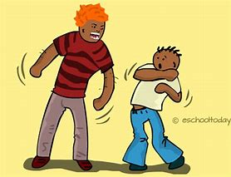
What is Bullying???
Repeated Verbal, social, physical, cyber, sexual or racial attacks on an individual.

Slide 3
What do Each of these mean?
Verbal
Sexual
Cyber
Social
Racial
Physical

Slide 4
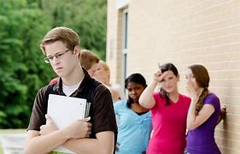
Verbal
Name Calling
Saying Cruel Things
Teasing
Intimidation
Threatening

Slide 5
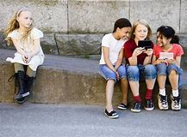
Social
Telling others not to play with someone
Gossiping
Leaving someone out on purpose

Slide 6
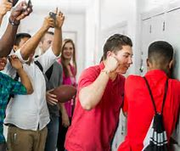
Physical
Pushing
Hitting
Hair pulling
Physical Contact

Slide 7
Cyber
Online
Social Media
Text Messages
Remember things added to the internet/social media do not go away. Anyone can save or screen shot what you did. This can all become evidence against the bully

Slide 8
Sexual
Saying/doing inappropriate gender related things

Slide 9
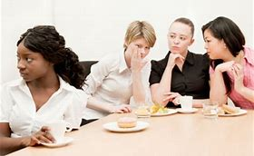
Racial
Saying cruel, negatives things about someone’s skin color or culture.

Slide 10
It’s okay to ask for help
Any form of bullying that happens just once is still an offense/crime and should be reported!
Reporting an offense/crime is not tattling.
No one has the right to make you feel scared or unsafe.

Slide 11
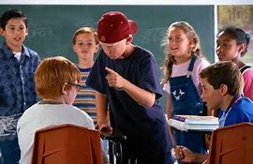
Who is involved in a bullying situation???
The bully
The victim
The bystanders

Slide 12
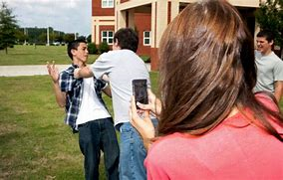
Bystanders
The bystanders are very important because they have the choice to:
Join in on the bullying (by laughing & encouraging it)
Just stand there and do nothing (either because they think it’s entertaining or too scared to do anything()
Be a defender (if it’s safe). Step up and tell the bully to stop. Others may then step up and do the same.

Slide 13
What to do if you are the victim
Get away from the bully and tell an adult.
Tell them to stop! Tell an adult.
Use reverse psychology (example: Someone says, “you are ugly” and you respond with “wow, thanks for letting me know that!)
Refrain from starting a physical fight with the bully or enlist others to bully them back (two wrongs don’t make a right)

Slide 14
What should you do if you are the bully
Ask yourself why you are doing these things (is it jealousy? A lot of times bullies are intimidated by the victim)
Talk to an adult about why you feel the way you do.
Just Stop.
Treat others the way they would want to be treated.

Slide 15
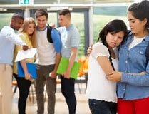
Bully Scenarios
Groups of 4
1 bully, 1 victim, and 2 bystanders
Create a short “skit” based off the scenario you’re given showing what each person does and says in the situation.

